Slide 1

William Stallings Computer Organization and Architecture 9th Edition
Notes:
Lecture slides prepared for “Computer Organization and Architecture”, 9/e, by William Stallings, Chapter 13 “Instruction Sets: Addressing Modes and Formats”.

Slide 2
Chapter 13
Instruction Sets: Addressing Modes and Formats
Notes:
In Chapter 12, we focused on what an instruction set does. Specifically, we examined the types of operands and operations that may be specified by machine instructions. This chapter turns to the question of how to specify the operands and operations of instructions. Two issues arise. First, how is the address of an operand specified, and second, how are the bits of an instruction organized to define the operand addresses and operation of that instruction?

Slide 3
Addressing Modes
Immediate
Direct
Indirect
Register
Register indirect
Displacement
Stack
Notes:
The address field or fields in a typical instruction format are relatively small. We would like to be able to reference a large range of locations in main memory or, for some systems, virtual memory. To achieve this objective, a variety of addressing techniques has been employed. They all involve some trade-off between address range and/or addressing flexibility, on the one hand, and the number of memory references in the instruction and/or the complexity of address calculation, on the other. In this section, we examine the most common addressing techniques, or modes:
• Immediate
• Direct • Indirect • Register
• Register indirect
• Displacement • Stack

Slide 4
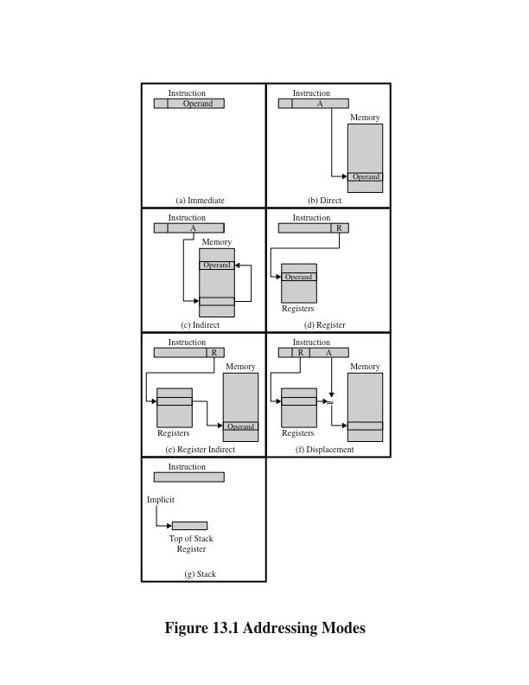
Addressing Modes
Notes:
These modes are illustrated in Figure 13.1. In this section, we use the following notation:
A = contents of an address field in the instruction R = contents of an address field in the instruction that refers to a register
EA = actual (effective) address of the location containing the referenced operand
(X) = contents of memory location X or register X

Slide 5
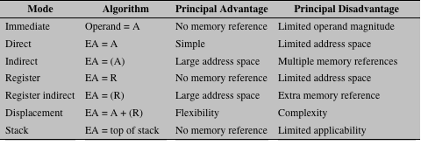
Basic Addressing Modes
Notes:
Table 13.1 indicates the address calculation performed for each addressing
mode.
Before beginning this discussion, two comments need to be made. First, virtually all computer architectures provide more than one of these addressing modes. The question arises as to how the processor can determine which address mode is being used in a particular instruction. Several approaches are taken. Often, different opcodes will use different addressing modes. Also, one or more bits in the instruction format can be used as a mode field. The value of the mode field deter- mines which addressing mode is to be used.
The second comment concerns the interpretation of the effective address (EA). In a system without virtual memory, the effective address will be either a main memory address or a register. In a virtual memory system, the effective address is a virtual address or a register. The actual mapping to a physical address is a function of the memory management unit (MMU) and is invisible to the programmer.

Slide 6

Immediate Addressing
Simplest form of addressing
Operand = A
This mode can be used to define and use constants or set initial values of variables
Typically the number will be stored in twos complement form
The leftmost bit of the operand field is used as a sign bit
Advantage:
no memory reference other than the instruction fetch is required to obtain the operand, thus saving one memory or cache cycle in the instruction cycle
Disadvantage:
The size of the number is restricted to the size of the address field, which, in most instruction sets, is small compared with the word length
Notes:
3
The simplest form of addressing is immediate addressing, in which the operand value is present in the instruction
Operand = A
This mode can be used to define and use constants or set initial values of variables. Typically, the number will be stored in twos complement form; the leftmost bit of the operand field is used as a sign bit. When the operand is loaded into a data register, the sign bit is extended to the left to the full data word size. In some cases, the immediate binary value is interpreted as an unsigned nonnegative integer.
The advantage of immediate addressing is that no memory reference other than the instruction fetch is required to obtain the operand, thus saving one memory or cache cycle in the instruction cycle. The disadvantage is that the size of the number is restricted to the size of the address field, which, in most instruction sets, is small compared with the word length.

Slide 7
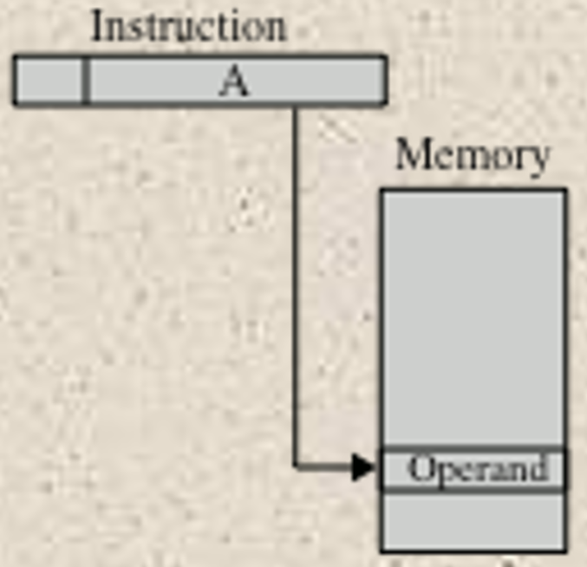
Direct Addressing
Address field contains the effective address of the operand
Effective address (EA) = address field (A)
Was common in earlier generations of computers
Requires only one memory reference and no special calculation
Limitation is that it provides only a limited address space
Notes:
5
A very simple form of addressing is direct addressing, in which the address field contains the effective address of the operand:
EA = A
The technique was common in earlier generations of computers but is not common on contemporary architectures. It requires only one memory reference and no special calculation. The obvious limitation is that it provides only a limited address space.

Slide 8
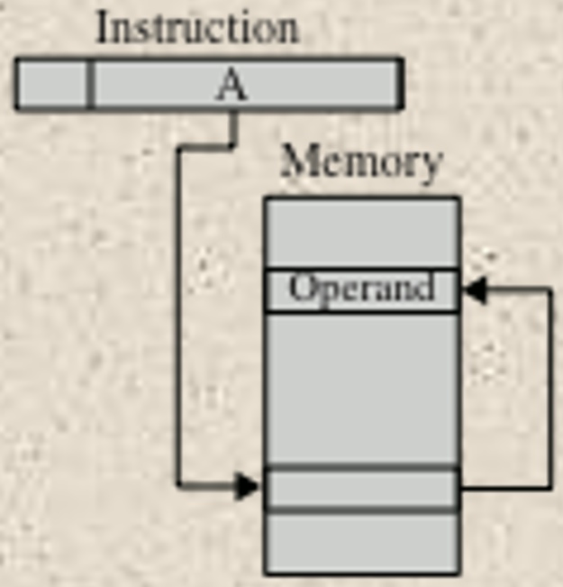
Indirect Addressing
Reference to the address of a word in memory which contains a full-length address of the operand
EA = (A)
Parentheses are to be interpreted as meaning contents of
Advantage:
For a word length of N an address space of 2^{N} is now available
Disadvantage:
Instruction execution requires two memory references to fetch the operand
One to get its address and a second to get its value
A rarely used variant of indirect addressing is multilevel or cascaded indirect addressing
EA = ( . . . (A) . . . )
Disadvantage is that three or more memory references could be required to fetch an operand
Notes:
7
With direct addressing, the length of the address field is usually less than the word length, thus limiting the address range. One solution is to have the address field refer to the address of a word in memory, which in turn contains a full-length address of the operand. This is known as indirect addressing:
EA = (A)
As defined earlier, the parentheses are to be interpreted as meaning contents of. The obvious advantage of this approach is that for a word length of N, an address space of 2^{N} is now available. The disadvantage is that instruction execution requires two memory references to fetch the operand: one to get its address and a second to get its value.
Although the number of words that can be addressed is now equal to 2^{N}, the number of different effective addresses that may be referenced at any one time is limited to 2^{K}, where K is the length of the address field. Typically, this is not a burdensome restriction, and it can be an asset. In a virtual memory environment, all the effective address locations can be confined to page 0 of any process. Because the address field of an instruction is small, it will naturally produce low-numbered direct addresses, which would appear in page 0. (The only restriction is that the page size must be greater than or equal to 2^{K}.) When a process is active, there will be repeated references to page 0, causing it to remain in real memory. Thus, an indirect memory reference will involve, at most, one page fault rather than two.
A rarely used variant of indirect addressing is multilevel or cascaded indirect addressing:
EA = ( . . . (A) . . . )
In this case, one bit of a full-word address is an indirect flag (I). If the I bit is 0, then the word contains the EA. If the I bit is 1, then another level of indirection is invoked. There does not appear to be any particular advantage to this approach, and its disadvantage is that three or more memory references could be required to fetch an operand.

Slide 9
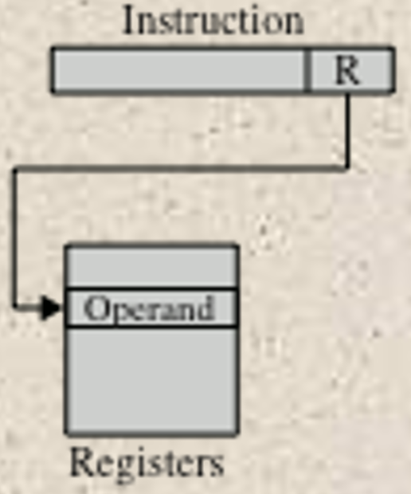
Register Addressing
Address field refers to a register rather than a main memory address
EA = R
Advantages:
Only a small address field is needed in the instruction
No time-consuming memory references are required
Disadvantage:
The address space is very limited
Notes:
10
Register addressing is similar to direct addressing. The only difference is that the address field refers to a register rather than a main memory address:
EA = R
To clarify, if the contents of a register address field in an instruction is 5, then register R5 is the intended address, and the operand value is contained in R5. Typically, an address field that references registers will have from 3 to 5 bits, so that a total of from 8 to 32 general-purpose registers can be referenced.
The advantages of register addressing are that (1) only a small address field is needed in the instruction, and (2) no time-consuming memory references are required. As was discussed in Chapter 4, the memory access time for a register internal to the processor is much less than that for a main memory address. The disadvantage of register addressing is that the address space is very limited.
If register addressing is heavily used in an instruction set, this implies that the processor registers will be heavily used. Because of the severely limited number of registers (compared with main memory locations), their use in this fashion makes sense only if they are employed efficiently. If every operand is brought into a register from main memory, operated on once, and then returned to main memory, then a wasteful intermediate step has been added. If, instead, the operand in a register remains in use for multiple operations, then a real savings is achieved. An example is the intermediate result in a calculation. In particular, suppose that the algorithm for twos complement multiplication were to be implemented in software. The location labeled A in the flowchart (Figure 10.12) is referenced many times and should be implemented in a register rather than a main memory location.
It is up to the programmer or compiler to decide which values should remain in registers and which should be stored in main memory. Most modern processors employ multiple general-purpose registers, placing a burden for efficient execution on the assembly-language programmer (e.g., compiler writer).

Slide 10
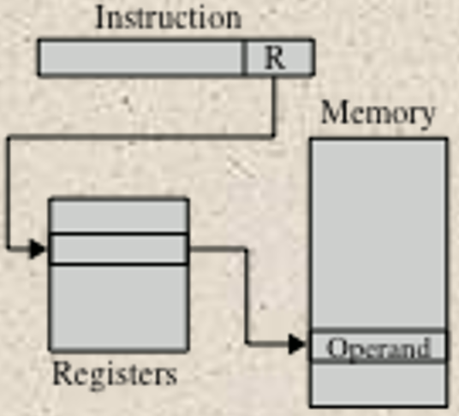
Register Indirect Addressing
Analogous to indirect addressing
The only difference is whether the address
field refers to a memory location or a register
EA = (R)
Address space limitation of the address field is overcome by having that field refer to a word-length location containing an address
Uses one less memory reference than indirect addressing
Notes:
13
Just as register addressing is analogous to direct addressing, register indirect addressing is analogous to indirect addressing. In both cases, the only difference is whether the address field refers to a memory location or a register. Thus, for register indirect address,
EA = (R)
The advantages and limitations of register indirect addressing are basically the same as for indirect addressing. In both cases, the address space limitation (limited range of addresses) of the address field is overcome by having that field refer to a word- length location containing an address. In addition, register indirect addressing uses one less memory reference than indirect addressing.

Slide 11
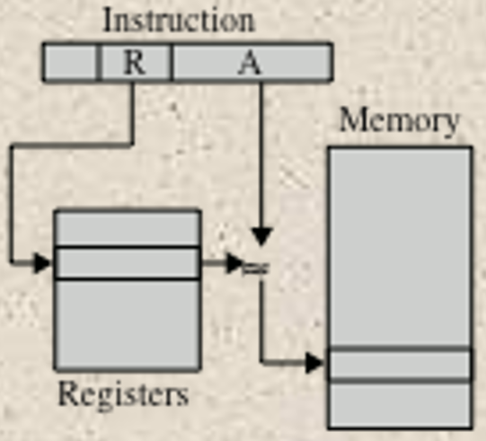
Displacement Addressing
Combines the capabilities of direct addressing and register indirect addressing
EA = A + (R)
Requires that the instruction have two address fields, at least one of which is explicit
The value contained in one address field (value = A) is used directly
The other address field refers to a register whose contents are added to A to produce the effective address
Most common uses:
Relative addressing
Base-register addressing
Indexing
Notes:
15
A very powerful mode of addressing combines the capabilities of direct addressing and register indirect addressing. It is known by a variety of names depending on the context of its use, but the basic mechanism is the same. We will refer to this as displacement addressing:
EA = A + ( R )
Displacement addressing requires that the instruction have two address fields, at least one of which is explicit. The value contained in one address field (value = A) is used directly. The other address field, or an implicit reference based on opcode, refers to a register whose contents are added to A to produce the effective address.
We will describe three of the most common uses of displacement addressing:
• Relative addressing • Base-register addressing
• Indexing

Slide 12
Relative Addressing
The implicitly referenced register is the program counter (PC)
The next instruction address is added to the address field to produce the EA
Typically the address field is treated as a twos complement number for this operation
Thus the effective address is a displacement relative to the address of the instruction
Exploits the concept of locality
Saves address bits in the instruction if most memory references are relatively near to the instruction being executed
Notes:
17
For relative addressing, also called PC-relative addressing, the implicitly referenced register is the program counter (PC). That is, the next instruction address is added to the address field to produce the EA. Typically, the address field is treated as a twos complement number for this operation. Thus, the effective address is a displacement relative to the address of the instruction.
Relative addressing exploits the concept of locality that was discussed in Chapters 4 and 8. If most memory references are relatively near to the instruction being executed, then the use of relative addressing saves address bits in the instruction.

Slide 13
Base-Register Addressing
The referenced register contains a main memory address and the address field contains a displacement from that address
The register reference may be explicit or implicit
Exploits the locality of memory references
Convenient means of implementing segmentation
In some implementations a single segment base register is employed and is used implicitly
In others the programmer may choose a register to hold the base address of a segment and the instruction must reference it explicitly
Notes:
18
For base-register addressing, the interpretation is the following: The referenced register contains a main memory address, and the address field contains a displacement (usually an unsigned integer representation) from that address. The register reference may be explicit or implicit.
Base-register addressing also exploits the locality of memory references. It is a convenient means of implementing segmentation, which was discussed in Chapter 8. In some implementations, a single segment-base register is employed and is used implicitly. In others, the programmer may choose a register to hold the base address of a segment, and the instruction must reference it explicitly. In this latter case, if the length of the address field is K and the number of possible registers is N, then one instruction can reference any one of N areas of 2^{K} words.

Slide 14
Indexed Addressing
The address field references a main memory address and the referenced register contains a positive displacement from that address
The method of calculating the EA is the same as for base-register addressing
An important use is to provide an efficient mechanism for performing iterative operations
Autoindexing
Automatically increment or decrement the index register after each reference to it
EA = A + (R)
(R) ⬅ (R) + 1
Postindexing
Indexing is performed after the indirection
EA = (A) + (R)
Preindexing
Indexing is performed before the indirection
EA = (A + (R))
Notes:
19
For indexing, the interpretation is typically the following: The address field references a main memory address, and the referenced register contains a positive displacement from that address. Note that this usage is just the opposite of the interpretation for base-register addressing. Of course, it is more than just a matter of user interpretation. Because the address field is considered to be a memory address in indexing, it generally contains more bits than an address field in a comparable base-register instruction. Also, we shall see that there are some refinements to indexing that would not be as useful in the base-register context. Nevertheless, the method of calculating the EA is the same for both base-register addressing and indexing, and in both cases the register reference is sometimes explicit and sometimes implicit (for different processor types).
An important use of indexing is to provide an efficient mechanism for per- forming iterative operations. Consider, for example, a list of numbers stored starting at location A. Suppose that we would like to add 1 to each element on the list. We need to fetch each value, add 1 to it, and store it back. The sequence of effective addresses that we need is A, A + 1, A + 2,..., up to the last location on the list. With indexing, this is easily done. The value A is stored in the instruction’s address field, and the chosen register, called an index register, is initialized to 0. After each operation, the index register is incremented by 1.
Because index registers are commonly used for such iterative tasks, it is typical that there is a need to increment or decrement the index register after
each reference to it. Because this is such a common operation, some systems will automatically do this as part of the same instruction cycle. This is known as autoindexing. If certain registers are devoted exclusively to indexing, then autoindexing can be invoked implicitly and automatically. If general-purpose registers are used, the autoindex operation may need to be signaled by a bit in the instruction.
In some machines, both indirect addressing and indexing are provided, and it is possible to employ both in the same instruction. There are two possibilities: the indexing is performed either before or after the indirection.
If indexing is performed after the indirection, it is termed postindexing.
First, the contents of the address field are used to access a memory location containing a direct address. This address is then indexed by the register value. This technique is useful for accessing one of a number of blocks of data of a fixed format. For example, it was described in Chapter 8 that the operating system needs to employ a process control block for each process. The operations performed are the same regardless of which block is being manipulated. Thus, the addresses in the instructions that reference the block could point to a location (value = A) containing a variable pointer to the start of a process control block. The index register contains the displacement within the block.
With preindexing, the indexing is performed before the indirection.
An address is calculated as with simple indexing. In this case, however, the calculated address contains not the operand, but the address of the operand. An example of the use of this technique is to construct a multiway branch table. At a particular point in a program, there may be a branch to one of a number of locations depending on conditions. A table of addresses can be set up starting at location A. By indexing into this table, the required location can be found.
Typically, an instruction set will not include both preindexing and postindexing.

Slide 15
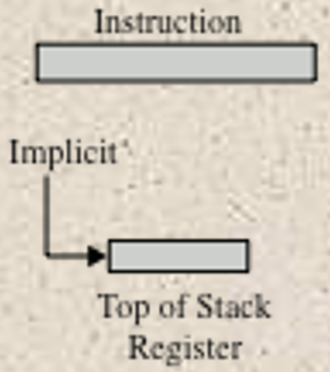
Stack Addressing
A stack is a linear array of locations
Sometimes referred to as a pushdown list or last-in-first-out queue
A stack is a reserved block of locations
Items are appended to the top of the stack so that the block is partially filled
Associated with the stack is a pointer whose value is the address of the top of the stack
The stack pointer is maintained in a register
Thus references to stack locations in memory are in fact register indirect addresses
Is a form of implied addressing
The machine instructions need not include a memory reference but implicitly operate on the top of the stack
Notes:
21
The final addressing mode that we consider is stack addressing. As defined in Appendix O, a stack is a linear array of locations. It is sometimes referred to as a pushdown list or last-in-first-out queue. The stack is a reserved block of locations. Items are appended to the top of the stack so that, at any given time, the block is partially filled. Associated with the stack is a pointer whose value is the address of the top of the stack. Alternatively, the top two elements of the stack may be in processor registers, in which case the stack pointer references the third element of the stack. The stack pointer is maintained in a register. Thus, references to stack locations in memory are in fact register indirect addresses.
The stack mode of addressing is a form of implied addressing. The machine instructions need not include a memory reference but implicitly operate on the top of the stack.

Slide 16
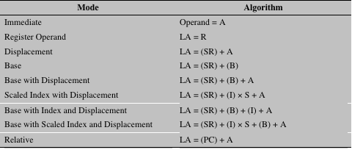
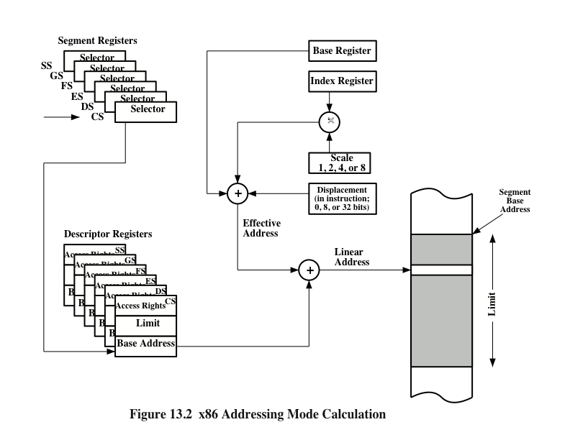
x86 Addressing Mode Calculation
Notes:
Recall from Figure 8.21 that the x86 address translation mechanism produces an address, called a virtual or effective address, that is an offset into a segment. The sum of the starting address of the segment and the effective address produces a linear address. If paging is being used, this linear address must pass through a page- translation mechanism to produce a physical address. In what follows, we ignore this last step because it is transparent to the instruction set and to the programmer.
The x86 is equipped with a variety of addressing modes intended to allow the efficient execution of high-level languages. Figure 13.2 indicates the logic involved. The segment register determines the segment that is the subject of the reference. There are six segment registers; the one being used for a particular reference depends on the context of execution and the instruction. Each segment register holds an index into the segment descriptor table (Figure 8.20), which holds the starting address of the corresponding segments. Associated with each user-visible segment register is a segment descriptor register (not programmer visible), which records the access rights for the segment as well as the starting address and limit (length) of the segment. In addition, there are two registers that may be used in constructing an address: the base register and the index register.

Slide 17
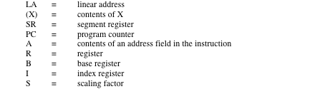
Table 13.2 x86 Addressing Modes
Notes:
Table 13.2 lists the x86 addressing modes. Let us consider each of these in turn.
For the immediate mode, the operand is included in the instruction. The operand can be a byte, word, or doubleword of data.
For register operand mode, the operand is located in a register. For general instructions, such as data transfer, arithmetic, and logical instructions, the operand can be one of the 32-bit general registers (EAX, EBX, ECX, EDX, ESI, EDI, ESP, EBP), one of the 16-bit general registers (AX, BX, CX, DX, SI, DI, SP, BP), or one of the 8-bit general registers (AH, BH, CH, DH, AL, BL, CL, DL). There are also some instructions that reference the segment selector registers (CS, DS, ES, SS, FS, GS).
The remaining addressing modes reference locations in memory. The memory location must be specified in terms of the segment containing the location and the off- set from the beginning of the segment. In some cases, a segment is specified explicitly; in others, the segment is specified by simple rules that assign a segment by default.
In the displacement mode, the operand’s offset (the effective address of Figure13.2) is contained as part of the instruction as an 8-, 16-, or 32-bit displacement. With segmentation, all addresses in instructions refer merely to an offset in a segment. The displacement addressing mode is found on few machines because, as mentioned earlier, it leads to long instructions. In the case of the x86,
the displacement value can be as long as 32 bits, making for a 6-byte instruction. Displacement addressing can be useful for referencing global variables.
The remaining addressing modes are indirect, in the sense that the address portion of the instruction tells the processor where to look to find the address. The base mode specifies that one of the 8-, 16-, or 32-bit registers contains the effective address. This is equivalent to what we have referred to as register indirect addressing.
In the base with displacement mode, the instruction includes a displacement to be added to a base register, which may be any of the general-purpose registers. Examples of uses of this mode are as follows:
Used by a compiler to point to the start of a local variable area. For example, the base register could point to the beginning of a stack frame, which contains the local variables for the corresponding procedure.
Used to index into an array when the element size is not 1, 2, 4, or 8 bytes and which therefore cannot be indexed using an index register. In this case, the displacement points to the beginning of the array, and the base register holds the results of a calculation to determine the offset to a specific element within the array.
Used to access a field of a record. The base register points to the beginning of the record, while the displacement is an offset to the field.
In the scaled index with displacement mode, the instruction includes a displacement to be added to a register, in this case called an index register. The index register may be any of the general-purpose registers except the one called ESP, which is generally used for stack processing. In calculating the effective address, the contents of the index register are multiplied by a scaling factor of 1, 2, 4, or 8, and then added to a displacement. This mode is very convenient for indexing arrays. A scaling factor of 2 can be used for an array of 16-bit integers. A scaling factor of 4 can be used for 32-bit integers or floating-point numbers. Finally, a scaling factor of 8 can be used for an array of double-precision floating-point numbers.
The base with index and displacement mode sums the contents of the base register, the index register, and a displacement to form the effective address. Again, the base register can be any general-purpose register and the index register can be any general-purpose register except ESP. As an example, this addressing mode could be used for accessing a local array on a stack frame. This mode can also be used to support a two-dimensional array; in this case, the displacement points to the beginning of the array, and each register handles one dimension of the array.
The based scaled index with displacement mode sums the contents of the index register multiplied by a scaling factor, the contents of the base register, and the displacement. This is useful if an array is stored in a stack frame; in this case, the array elements would be 2, 4, or 8 bytes each in length. This mode also provides efficient indexing of a two-dimensional array when the array elements are 2, 4, or 8 bytes in length.
Finally, relative addressing can be used in transfer-of-control instructions. A displacement is added to the value of the program counter, which points to the next instruction. In this case, the displacement is treated as a signed byte, word, or doubleword value, and that value either increases or decreases the address in the program counter.

Slide 18
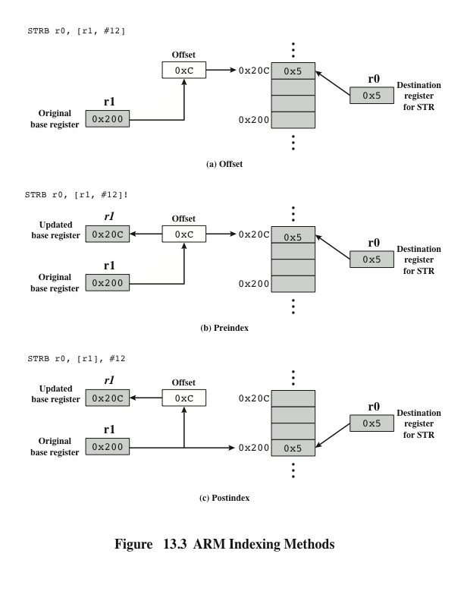
ARM Indexing Methods
Load and store instructions are the only instructions that reference memory. This is always done indirectly through a base register plus offset
Notes:
Load and store instructions are the only instructions that reference memory. This is always done indirectly through a base register plus offset. There are three alternatives with respect to indexing (Figure 13.3):
• Offset: For this addressing method, indexing is not used. An offset value is added to or subtracted from the value in the base register to form the memory address. As an example Figure 13.3a illustrates this method with the assembly language instruction STRB r0, [r1, #12]. This is the store byte instruction. In this case the base address is in register r1 and the displacement is an immediate value of decimal 12. The resulting address (base plus offset) is the location where the least significant byte from r0 is to be stored.
• Preindex: The memory address is formed in the same way as for off set addressing. The memory address is also written back to the base register. In other words, the base register value is incremented or decremented by the offset value. Figure 13.3b illustrates this method with the assembly language instruction STRB r0, [r1, #12]!. The exclamation point signifies preindexing.
• Postindex: The memory address is the base register value. An offset is added to or subtracted from the base register value and the result is written back to the base register. Figure 13.3c illustrates this method with the assembly language instruction STRB r0, [r1], #12.
Note that what ARM refers to as a base register acts as an index register for preindex and postindex addressing. The offset value can either be an immediate value stored in the instruction or it can be in another register. If the offset value is in a register, another useful feature is available: scaled register addressing. The value in the offset register is scaled by one of the shift operators: Logical Shift Left, Logical Shift Right, Arithmetic Shift Right, Rotate Right, or Rotate Right Extended (which includes the carry bit in the rotation). The amount of the shift is specified as an immediate value in the instruction.

Slide 19
ARM Data Processing Instruction Addressing and Branch Instructions
Data processing instructions
Use either register addressing or a mixture of register and immediate addressing
For register addressing the value in one of the register operands may be scaled using one of the five shift operators
Branch instructions
The only form of addressing for branch instructions is immediate
Instruction contains 24 bit value
Shifted 2 bits left so that the address is on a word boundary
Effective range +/-32MB from from the program counter
Notes:
Data processing instructions use either register addressing or a mixture of register and immediate addressing. For register addressing, the value in one of the register operands may be scaled using one of the five shift operators defined in the preceding paragraph.
The only form of addressing for branch instructions is immediate addressing. The branch instruction contains a 24-bit value. For address calculation, this value is shifted left 2 bits, so that the address is on a word boundary. Thus the effective address range is { 32 MB from the program counter.

Slide 20
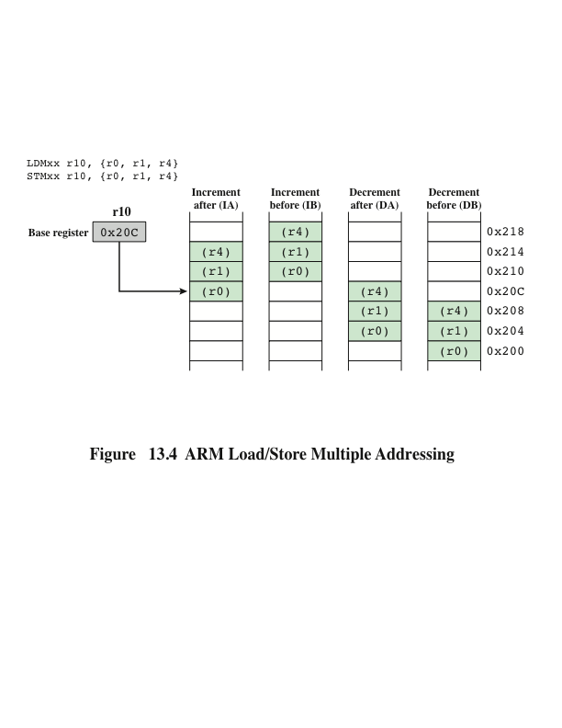
ARM Load/Store Multiple Addressing
Notes:
Load Multiple instructions load a subset (possibly all) of the general-purpose registers from memory. Store Multiple instructions store a subset (possibly all) of the general-purpose registers to memory. The list of registers for the load or store is specified in a 16-bit field in the instruction with each bit corresponding to one of the 16 registers. Load and Store Multiple addressing modes produce a sequential range of memory addresses. The lowest-numbered register is stored at the lowest memory address and the highest- numbered register at the highest memory address. Four addressing modes are used
(Figure 13.4): increment after, increment before, decrement after, and decrement before. A base register specifies a main memory address where register values are stored in or loaded from in ascending (increment) or descending (decrement) word locations. Incrementing or decrementing starts either before or after the first memory access.
These instructions are useful for block loads or stores, stack operations, and procedure exit sequences.

Slide 21
Instruction Formats
Define the layout of the bits of an instruction, in terms of its constituent fields
Must include an opcode and, implicitly or explicitly, indicate the addressing mode for each operand
For most instruction sets more than one instruction format is used
Notes:
An instruction format defines the layout of the bits of an instruction, in terms of its constituent fields. An instruction format must include an opcode and, implicitly or explicitly, zero or more operands. Each explicit operand is referenced using one of the addressing modes described in Section 13.1. The format must, implicitly or explicitly, indicate the addressing mode for each operand. For most instruction sets, more than one instruction format is used.
The design of an instruction format is a complex art, and an amazing variety of designs have been implemented. We examine the key design issues, looking briefly at some designs to illustrate points, and then we examine the x86 and ARM solutions in detail.

Slide 22
Instruction Length
Most basic design issue
Affects, and is affected by:
Memory size
Memory organization
Bus structure
Processor complexity
Processor speed
Should be equal to the memory-transfer length or one should be a multiple of the other
Should be a multiple of the character length, which is usually 8 bits, and of the length of fixed-point numbers
Notes:
The most basic design issue to be faced is the instruction format length. This decision affects, and is affected by, memory size, memory organization, bus structure, processor complexity, and processor speed. This decision determines the richness and flexibility of the machine as seen by the assembly-language programmer.
The most obvious trade-off here is between the desire for a powerful instruction repertoire and a need to save space. Programmers want more opcodes, more operands, more addressing modes, and greater address range. More opcodes and more operands make life easier for the programmer, because shorter programs can be written to accomplish given tasks. Similarly, more addressing modes give the programmer greater flexibility in implementing certain functions, such as table manipulations and multiple-way branching. And, of course, with the increase in main memory size and the increasing use of virtual memory, programmers want to be able to address larger memory ranges. All of these things (opcodes, operands, addressing modes, address range) require bits and push in the direction of longer instruction lengths. But longer instruction length may be wasteful. A 64-bit instruction occupies twice the space of a 32-bit instruction but is probably less than twice as useful.
Beyond this basic trade-off, there are other considerations. Either the instruction length should be equal to the memory-transfer length (in a bus system, data- bus length) or one should be a multiple of the other. Otherwise, we will not get an integral number of instructions during a fetch cycle. A related consideration is the memory transfer rate. This rate has not kept up with increases in processor speed. Accordingly, memory can become a bottleneck if the processor can execute instructions faster than it can fetch them. One solution to this problem is to use cache memory (see Section 4.3); another is to use shorter instructions. Thus, 16-bit instructions can be fetched at twice the rate of 32-bit instructions but probably can be executed less than twice as rapidly.
A seemingly mundane but nevertheless important feature is that the instruction length should be a multiple of the character length, which is usually 8 bits, and of the length of fixed-point numbers. To see this, we need to make use of that unfortunately ill-defined word, word [FRAI83]. The word length of memory is, in some sense, the “natural” unit of organization. The size of a word usually determines the size of fixed-point numbers (usually the two are equal). Word size is also typically equal to, or at least integrally related to, the memory transfer size. Because a common form of data is character data, we would like a word to store an integral number of characters. Otherwise, there are wasted bits in each word when storing multiple characters, or a character will have to straddle a word boundary. The importance of this point is such that IBM, when it introduced the System/360 and wanted to employ 8-bit characters, made the wrenching decision to move from the 36-bit architecture of the scientific members of the 700/7000 series to a 32-bit architecture.

Slide 23
Allocation of Bits
Number of addressing modes
Number of operands
Register versus memory
Number of register sets
Address range
Address granularity
Notes:
We’ve looked at some of the factors that go into deciding the length of the instruction format. An equally difficult issue is how to allocate the bits in that format. The trade-offs here are complex.
For a given instruction length, there is clearly a trade-off between the number of opcodes and the power of the addressing capability. More opcodes obviously mean more bits in the opcode field. For an instruction format of a given length, this reduces the number of bits available for addressing. There is one interesting refinement to this trade-off, and that is the use of variable-length opcodes. In this approach, there is a minimum opcode length but, for some opcodes, additional operations may be specified by using additional bits in the instruction. For a fixed- length instruction, this leaves fewer bits for addressing. Thus, this feature is used for those instructions that require fewer operands and/or less powerful addressing.
The following interrelated factors go into determining the use of the addressing bits.
Number of addressing modes: Sometimes an addressing mode can be indicated implicitly. For example, certain opcodes might always call for indexing. In other cases, the addressing modes must be explicit, and one or more mode bits will be needed.
Number of operands: We have seen that fewer addresses can make for longer, more awkward programs (e.g., Figure 10.3). Typical instruction formats on today’s machines include two operands. Each operand address in the instruction might require its own mode indicator, or the use of a mode indicator could be limited to just one of the address fields.
Register versus memory: A machine must have registers so that data can be brought into the processor for processing. With a single user-visible register (usually called the accumulator), one operand address is implicit and consumes no instruction bits. However, single-register programming is awkward and requires many instructions. Even with multiple registers, only a few bits are needed to specify the register. The more that registers can be used for operand references, the fewer bits are needed. A number of studies indicate that a total of 8 to 32 user-visible registers is desirable [LUND77, HUCK83]. Most contemporary architectures have at least 32 registers.
Number of register sets: Most contemporary machines have one set of general- purpose registers, with typically 32 or more registers in the set. These registers can be used to store data and can be used to store addresses for displacement addressing. Some architectures, including that of the x86, have a collection of two or more specialized sets (such as data and displacement). One advantage of this latter approach is that, for a fixed number of registers, a functional split requires fewer bits to be used in the instruction. For example, with two sets of eight registers, only 3 bits are required to identify a register; the opcode or mode register will determine which set of registers is being referenced.
Address range: For addresses that reference memory, the range of addresses that can be referenced is related to the number of address bits. Because this imposes a severe limitation, direct addressing is rarely used. With displacement addressing, the range is opened up to the length of the address register. Even so, it is still convenient to allow rather large displacements from the register address, which requires a relatively large number of address bits in the instruction.
Address granularity: For addresses that reference memory rather than registers, another factor is the granularity of addressing. In a system with 16- or 32-bit words, an address can reference a word or a byte at the designer’s choice. Byte addressing is convenient for character manipulation but requires, for a fixed-size memory, more address bits.
Thus, the designer is faced with a host of factors to consider and balance.
How critical the various choices are is not clear. As an example, we cite one study [CRAG79] that compared various instruction format approaches, including the use of a stack, general-purpose registers, an accumulator, and only memory-to-register approaches. Using a consistent set of assumptions, no significant difference in code space or execution time was observed.

Slide 24
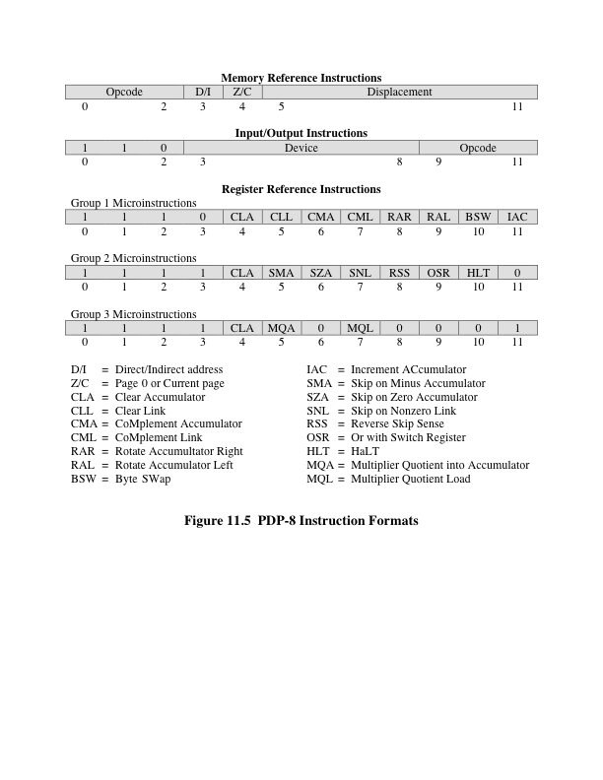
PDP-8 Instruction Format
Notes:
One of the simplest instruction designs for a general-purpose computer was for the PDP-8 [BELL78b]. The PDP-8 uses 12-bit instructions and operates on 12-bit words. There is a single general-purpose register, the accumulator.
Despite the limitations of this design, the addressing is quite flexible. Each memory reference consists of 7 bits plus two 1-bit modifiers. The memory is divided into fixed-length pages of 2⁷ = 128 words each. Address calculation is based on references to page 0 or the current page (page containing this instruction) as determined by the page bit. The second modifier bit indicates whether direct or indirect addressing is to be used. These two modes can be used in combination, so that an indirect address is a 12-bit address contained in a word of page 0 or the current page. In addition, 8 dedicated words on page 0 are autoindex “registers.” When an indirect reference is made to one of these locations, preindexing occurs.
Figure 13.5 shows the PDP-8 instruction format. There are a 3-bit opcode and three types of instructions. For opcodes 0 through 5, the format is a single-address memory reference instruction including a page bit and an indirect bit. Thus, there are only six basic operations. To enlarge the group of operations, opcode 7 defines a register reference or microinstruction. In this format, the remaining bits are used to encode additional operations. In general, each bit defines a specific operation (e.g., clear accumulator), and these bits can be combined in a single instruction. The microinstruction strategy was used as far back as the PDP-1 by DEC and is, in a sense, a forerunner of today’s microprogrammed machines, to be discussed in Part Four. Opcode 6 is the I/O operation; 6 bits are used to select one of 64 devices, and 3 bits specify a particular I/O command.
The PDP-8 instruction format is remarkably efficient. It supports indirect addressing, displacement addressing, and indexing. With the use of the opcode extension, it supports a total of approximately 35 instructions. Given the constraints of a 12-bit instruction length, the designers could hardly have done better.

Slide 25
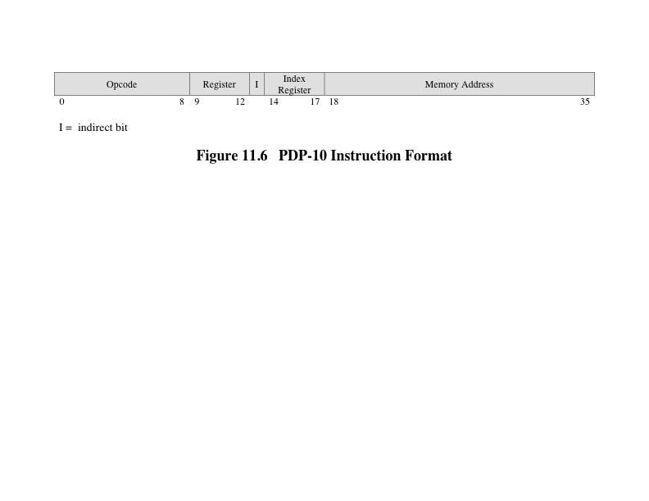
PDP-10 Instruction Format
Notes:
sharp contrast to the instruction set of the PDP-8 is that of the PDP-10. The PDP-10 was designed to be a large-scale time-shared system, with an emphasis on making the system easy to program, even if additional hardware expense was involved.
Among the design principles employed in designing the instruction set were the following [BELL78c]:
• Orthogonality: Orthogonality is a principle by which two variables are independent of each other. In the context of an instruction set, the term indicates that other elements of an instruction are independent of (not determined by) the opcode. The PDP-10 designers use the term to describe the fact that an address is always computed in the same way, independent of the opcode. This is in contrast to many machines, where the address mode sometimes depends implicitly on the operator being used.
• Completeness: Each arithmetic data type (integer, fixed-point, floating-point) should have a complete and identical set of operations.
• Direct addressing: Base plus displacement addressing, which places a memory organization burden on the programmer, was avoided in favor of direct addressing.
Each of these principles advances the main goal of ease of programming.
The PDP-10 has a 36-bit word length and a 36-bit instruction length. The fixed instruction format is shown in Figure 13.6. The opcode occupies 9 bits, allowing up to 512 operations. In fact, a total of 365 different instructions are defined. Most instructions have two addresses, one of which is one of 16 general-purpose registers. Thus, this operand reference occupies 4 bits. The other operand reference starts with an 18-bit memory address field. This can be used as an immediate operand or a memory address. In the latter usage, both indexing and indirect addressing are
allowed. The same general-purpose registers are also used as index registers.
A 36-bit instruction length is true luxury. There is no need to do clever things to get more opcodes; a 9-bit opcode field is more than adequate. Addressing is also straightforward. An 18-bit address field makes direct addressing desirable. For memory sizes greater than 218, indirection is provided. For the ease of the programmer, indexing is provided for table manipulation and iterative programs. Also, with an 18-bit operand field, immediate addressing becomes attractive.
The PDP-10 instruction set design does accomplish the objectives listed earlier [LUND77]. It eases the task of the programmer or compiler at the expense of an inefficient utilization of space. This was a conscious choice made by the designers and therefore cannot be faulted as poor design.

Slide 26
Variable-Length Instructions
Variations can be provided efficiently and compactly
Increases the complexity of the processor
Does not remove the desirability of making all of the instruction lengths integrally related to word length
Because the processor does not know the length of the next instruction to be fetched a typical strategy is to fetch a number of bytes or words equal to at least the longest possible instruction
Sometimes multiple instructions are fetched
Notes:
The examples we have looked at so far have used a single fixed instruction length, and we have implicitly discussed trade-offs in that context. But the designer may choose instead to provide a variety of instruction formats of different lengths. This tactic makes it easy to provide a large repertoire of opcodes, with different opcode lengths. Addressing can be more flexible, with various combinations of register and memory references plus addressing modes. With variable-length instructions, these many variations can be provided efficiently and compactly.
The principal price to pay for variable-length instructions is an increase in the complexity of the processor. Falling hardware prices, the use of microprogramming (discussed in Part Four), and a general increase in understanding the principles of processor design have all contributed to making this a small price to pay. However, we will see that RISC and superscalar machines can exploit the use of fixed-length instructions to provide improved performance.
The use of variable-length instructions does not remove the desirability of making all of the instruction lengths integrally related to the word length. Because the processor does not know the length of the next instruction to be fetched, a typical strategy is to fetch a number of bytes or words equal to at least the longest possible instruction. This means that sometimes multiple instructions are fetched. However, as we shall see in Chapter 14, this is a good strategy to follow in any case.

Slide 27
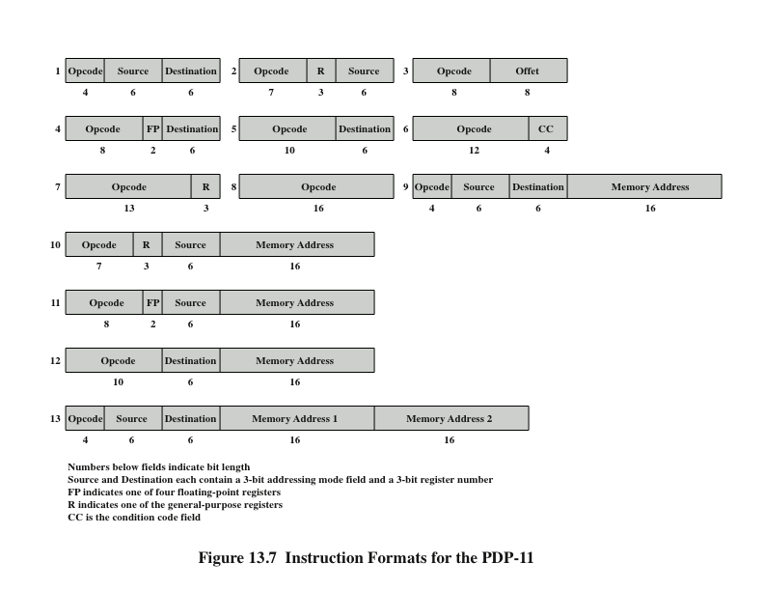
PDP-11 Instruction Format
Notes:
The PDP-11 was designed to provide a powerful and flexible instruction set within the constraints of a 16-bit minicomputer [BELL70].
The PDP-11 employs a set of eight 16-bit general-purpose registers. Two of these registers have additional significance: one is used as a stack pointer for special-purpose stack operations, and one is used as the program counter, which contains the address of the next instruction.
Figure 13.7 shows the PDP-11 instruction formats. Thirteen different formats are used, encompassing zero-, one-, and two-address instruction types. The opcode can vary from 4 to 16 bits in length. Register references are 6 bits in length. Three bits identify the register, and the remaining 3 bits identify the addressing mode. The PDP-11 is endowed with a rich set of addressing modes. One advantage of linking the addressing mode to the operand rather than the opcode, as is sometimes done, is that any addressing mode can be used with any opcode. As was mentioned, this independence is referred to as orthogonality.
PDP-11 instructions are usually one word (16 bits) long. For some instructions, one or two memory addresses are appended, so that 32-bit and 48-bit instructions are part of the repertoire. This provides for further flexibility in addressing.
The PDP-11 instruction set and addressing capability are complex. This increases both hardware cost and programming complexity. The advantage is that more efficient or compact programs can be developed.

Slide 28
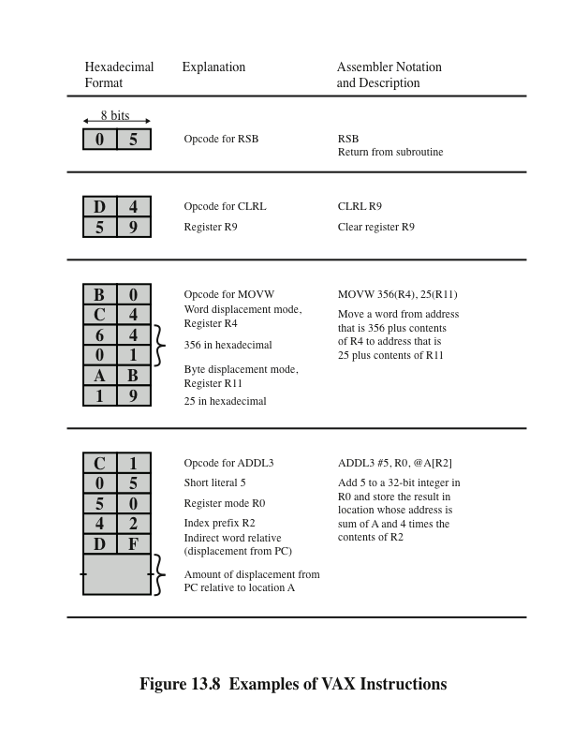
VAX Instruction Examples
Notes:
Most architectures provide a relatively small number of fixed instruction formats. This can cause two problems for the programmer. First, addressing mode and opcode are not orthogonal. For example, for a given operation, one operand must come from a register and another from memory, or both from registers, and so on. Second, only a limited number of operands can be accommodated: typically up to two or three. Because some operations inherently require more operands, various strategies must be used to achieve the desired result using two or more instructions.
To avoid these problems, two criteria were used in designing the VAX instruction format [STRE78]:
All instructions should have the “natural” number of operands.
All operands should have the same generality in specification.
The result is a highly variable instruction format. An instruction consists of a 1- or 2-byte opcode followed by from zero to six operand specifiers, depending on the opcode. The minimal instruction length is 1 byte, and instructions up to 37 bytes can be constructed. Figure 13.8 gives a few examples.
The VAX instruction begins with a 1-byte opcode. This suffices to handle most VAX instructions. However, as there are over 300 different instructions, 8 bits are not enough. The hexadecimal codes FD and FF indicate an extended opcode, with the actual opcode being specified in the second byte.
The remainder of the instruction consists of up to six operand specifiers. An operand specifier is, at minimum, a 1-byte format in which the leftmost 4 bits are the address mode specifier. The only exception to this rule is the literal mode, which is signaled by the pattern 00 in the leftmost 2 bits, leaving space for a 6-bit literal. Because of this exception, a total of 12 different addressing modes can be specified.
An operand specifier often consists of just one byte, with the rightmost 4 bits specifying one of 16 general-purpose registers. The length of the operand specifier can be extended in one of two ways. First, a constant value of one or more bytes may immediately follow the first byte of the operand specifier. An example of this is the displacement mode, in which an 8-, 16-, or 32-bit displacement is used. Second, an index mode of addressing may be used. In this case, the first byte of the operand specifier consists of the 4-bit addressing mode code of 0100 and a 4-bit index register identifier. The remainder of the operand specifier consists of the base address specifier, which may itself be one or more bytes in length.
The VAX instruction set provides for a wide variety of operations and addressing modes. This gives a programmer, such as a compiler writer, a very powerful and flexible tool for developing programs. In theory, this should lead to efficient machine-language compilations of high-level language programs and, in general, to effective and efficient use of processor resources. The penalty to be paid for these benefits is the increased complexity of the processor compared with a processor with a simpler instruction set and format.

Slide 29
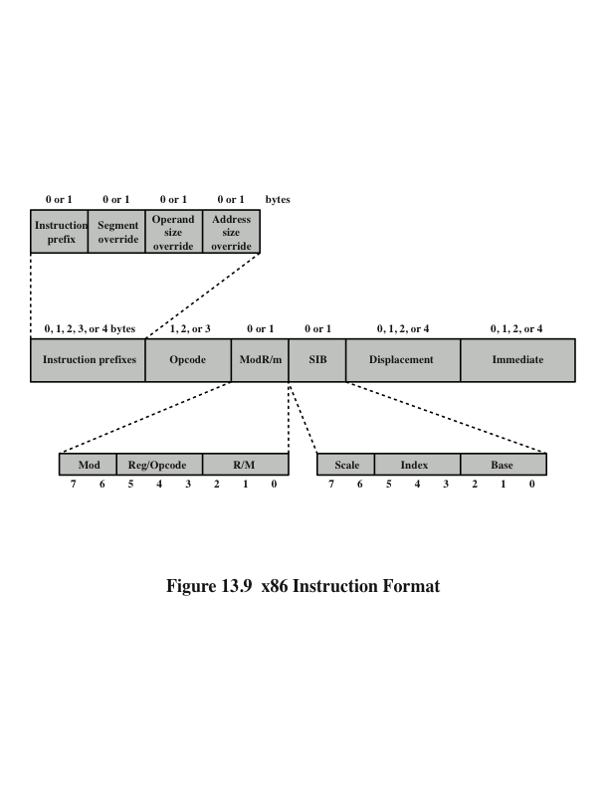
x86 Instruction Format
x86 is equipped with a variety of instruction formats
Notes:
he x86 is equipped with a variety of instruction formats. Of the elements described in this subsection, only the opcode field is always present. Figure 13.9 illustrates the general instruction format. Instructions are made up of from zero to four optional instruction prefixes, a 1- or 2-byte opcode, an optional address specifier (which consists of the ModR/M byte and the Scale Index Base byte) an optional displacement, and an optional immediate field.
As can be seen, the encoding of the x86 instruction set is very complex. This has to do partly with the need to be backward compatible with the 8086 machine and partly with a desire on the part of the designers to provide every possible assistance to the compiler writer in producing efficient code. It is a matter of some debate whether an instruction set as complex as this is preferable to the opposite extreme of the RISC instruction sets.

Slide 30
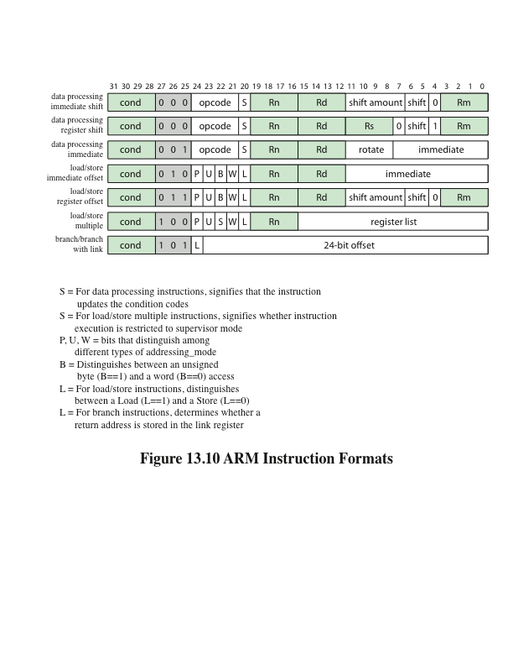
ARM Instruction Formats
Notes:
Figure 13.10 ARM Instruction Formats

Slide 31
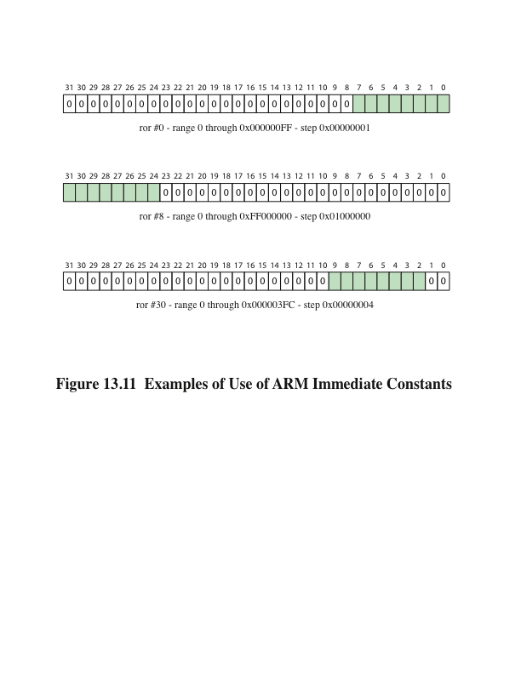
Examples of Use of ARM Immediate Constants
Notes:
To achieve a greater range of immediate values, the data processing immediate format specifies both an immediate value and a rotate value. The 8-bit immediate value is expanded to 32 bits and then rotated right by a number of bits equal to twice the 4-bit rotate value. Several examples are shown in Figure 13.11.

Slide 32
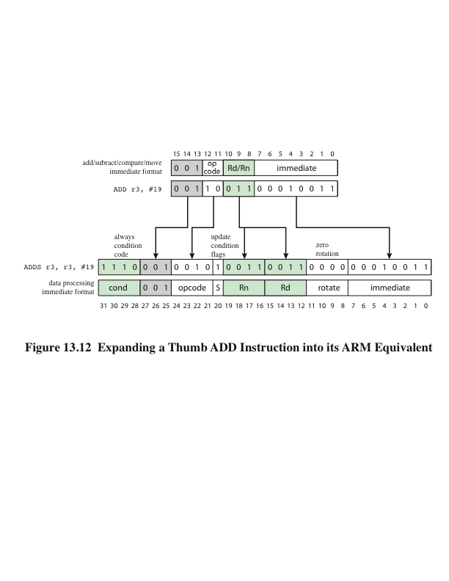
Thumb Instruction Set
Notes:
The Thumb instruction set is a re-encoded subset of the ARM instruction set. Thumb is designed to increase the performance of ARM implementations that use a 16-bit or narrower memory data bus and to allow better code density than provided by the ARM instruction set. The Thumb instruction set contains a subset of the ARM 32-bit instruction set recoded into 16-bit instructions. The savings is achieved in the following way:
Thumb instructions are unconditional, so the condition code field is not used. Also, all Thumb arithmetic and logic instructions update the condition flags, so that the update-flag bit is not needed. Savings: 5 bits.
Thumb has only a subset of the operations in the full instruction set and uses only a 2-bit opcode field, plus a 3-bit type field. Savings: 2 bits.
The remaining savings of 9 bits comes from reductions in the operand specifications. For example, Thumb instructions reference only registers r0 through r7, so only 3 bits are required for register references, rather than 4 bits. Immediate values do not include a 4-bit rotate field.
The ARM processor can execute a program consisting of a mixture of Thumb
instructions and 32-bit ARM instructions. A bit in the processor control register determines which type of instruction is currently being executed. Figure 13.12 shows an example. The figure shows both the general format and a specific instance of an instruction in both 16-bit and 32-bit formats.

Slide 33
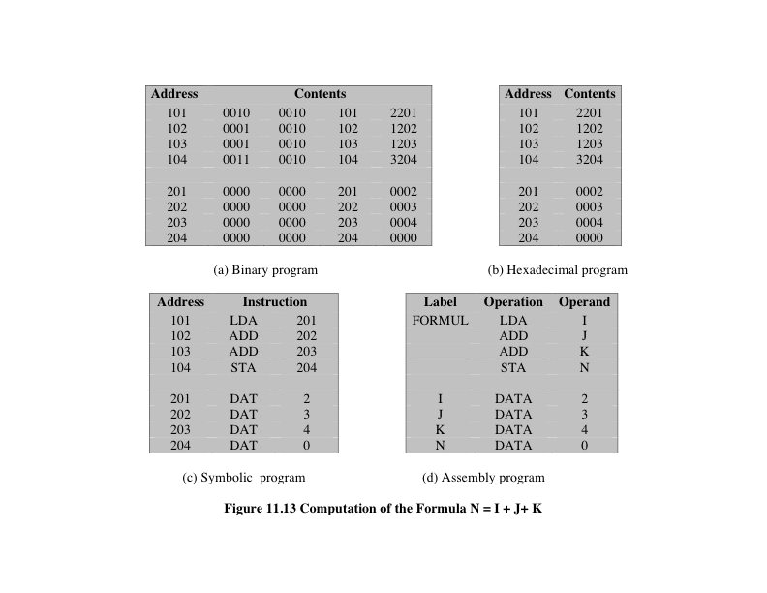
Assembler
Notes:
A processor can understand and execute machine instructions. Such instructions are simply binary numbers stored in the computer. If a programmer wished to program directly in machine language, then it would be necessary to enter the program as binary data.
Consider the simple BASIC statement N=I+J+K
Suppose we wished to program this statement in machine language and to initialize I, J, and K to 2, 3, and 4, respectively. This is shown in Figure 13.13a. The program starts in location 101 (hexadecimal). Memory is reserved for the four variables starting at location 201. The program consists of four instructions:
Load the contents of location 201 into the AC.
Add the contents of location 202 to the AC.
Add the contents of location 203 to the AC.
Store the contents of the AC in location 204.
This is clearly a tedious and very error-prone process.
A slight improvement is to write the program in hexadecimal rather than
binary notation (Figure 10.11b). We could write the program as a series of lines. Each line contains the address of a memory location and the hexadecimal code of the binary value to be stored in that location. Then we need a program that will accept this input, translate each line into a binary number, and store it in the specified location.
For more improvement, we can make use of the symbolic name or mnemonic of each instruction. This results in the symbolic program shown in Figure 10.11c. Each line of input still represents one memory location. Each line consists of three fields, separated by spaces. The first field contains the address of a location. For an instruction, the second field contains the three-letter symbol for the opcode. If it is a memory-referencing instruction, then a third field contains the address. To store arbitrary data in a location, we invent a pseudoinstruction with the symbol DAT. This is merely an indication that the third field on the line contains a hexadecimal number to be stored in the location specified in the first field.
For this type of input we need a slightly more complex program. The program accepts each line of input, generates a binary number based on the second and third (if present) fields, and stores it in the location specified by the first field.
The use of a symbolic program makes life much easier but is still awkward. In particular, we must give an absolute address for each word. This means that the program and data can be loaded into only one place in memory, and we must know that place ahead of time. Worse, suppose we wish to change the program some day by adding or deleting a line. This will change the addresses of all subsequent words.
A much better system, and one commonly used, is to use symbolic addresses. This is illustrated in Figure 10.11d. Each line still consists of three fields. The first field is still for the address, but a symbol is used instead of an absolute numerical address. Some lines have no address, implying that the address of that line is one more than the address of the previous line. For memory-reference instructions, the third field also contains a symbolic address.
With this last refinement, we have an assembly language. Programs written in assembly language (assembly programs) are translated into machine language by an assembler. This program must not only do the symbolic translation discussed earlier but also assign some form of memory addresses to symbolic addresses.
The development of assembly language was a major milestone in the evolution of computer technology. It was the first step to the high-level languages in use today. Although few programmers use assembly language, virtually all machines provide one. They are used, if at all, for systems programs such as compilers and I/O routines.

Slide 34
Summary
Instruction Sets: Addressing Modes and Formats
Chapter 13
x86 addressing modes
ARM addressing modes
Instruction formats
Instruction length
Allocation of bits
Variable-length instructions
X86 instruction formats
ARM instruction formats
Addressing modes
Immediate addressing
Direct addressing
Indirect addressing
Register addressing
Register indirect addressing
Displacement addressing
Stack addressing
Notes:
Chapter 13 summary.

